Slide 1

Apple Leaf Disease Detection
6100 Big Data Analytics for Competitive Advantage
Presented By: Group 16

Slide 2
Team Members and their Responsibilities
Avinash Konda – Model Development
Pooja Reddy – Data Cleaning and Exploration
Ashmitha Reddy – Streamlit Deployment

Slide 3
Project Description
Applied deep learning to detect visual symptoms of diseases in apple leaves
Built a multi-class classifier capable of identifying Healthy, Rust, Scab, and Multiple Diseases
Leveraged ResNet50 pretrained on ImageNet for robust feature extraction
Trained and fine-tuned the model using the Plant Pathology 2020 Kaggle dataset
Deployed the model via a Streamlit app for real-time prediction with image uploads

Slide 4
Dataset Overview
Sourced from the Kaggle Plant Pathology 2020 competition dataset
Contains 1,800+ labeled images of apple leaves captured under various conditions
Images are labeled into one of four classes: Healthy, Rust, Scab, Multiple Diseases
Each image is stored in high-resolution JPEG format suitable for CNN processing
Data is split into training and test sets with unique image identifiers
Dataset is ideal for multi-class classification and real-world agricultural applications

Slide 5
Data Preprocessing
Verified and cleaned image paths using the provided CSV files
Resized all images to 224x224 to match model input requirements
Converted images to RGB format using PIL for consistent channel depth
Normalized pixel values based on ImageNet mean and std (standardization)
Wrapped data loading with PyTorch Dataset and DataLoader classes
Enabled optional image augmentations for improved model generalization

Slide 6
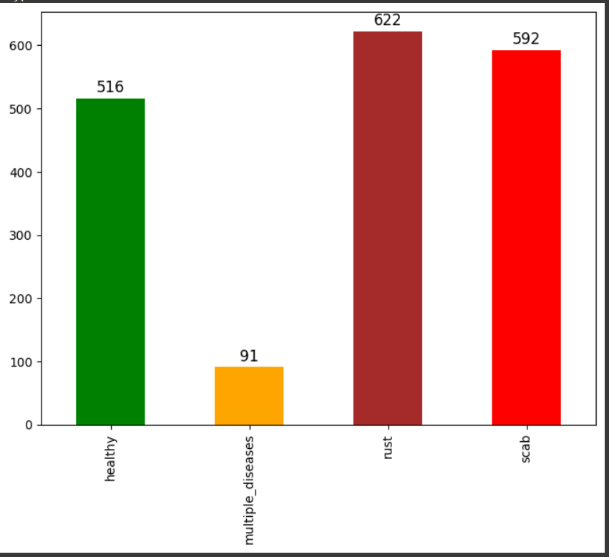
Data Exploration
Checked dataset shape, column types, and class distribution
Visualized class frequency using bar plots for healthy, rust, scab, and multiple diseases
Displayed example images with corresponding labels for visual inspection
Analyzed pixel value ranges and image dimensions to detect outliers
Reviewed class balance to ensure sufficient representation of each disease type
Identified any duplicate or corrupted images for removal or correction

Slide 7
Model Selection
Compared several CNN-based architectures for performance and complexity
Simple CNN: Used as a baseline reference model
ResNet18: Faster but less expressive; useful for comparison
EfficientNet-B0: Strong accuracy but more complex
VGG16 and MobileNetV2: Traditional and mobile-friendly alternatives
Selected Model: ResNet50 — best balance of accuracy and transfer learning power

Slide 8
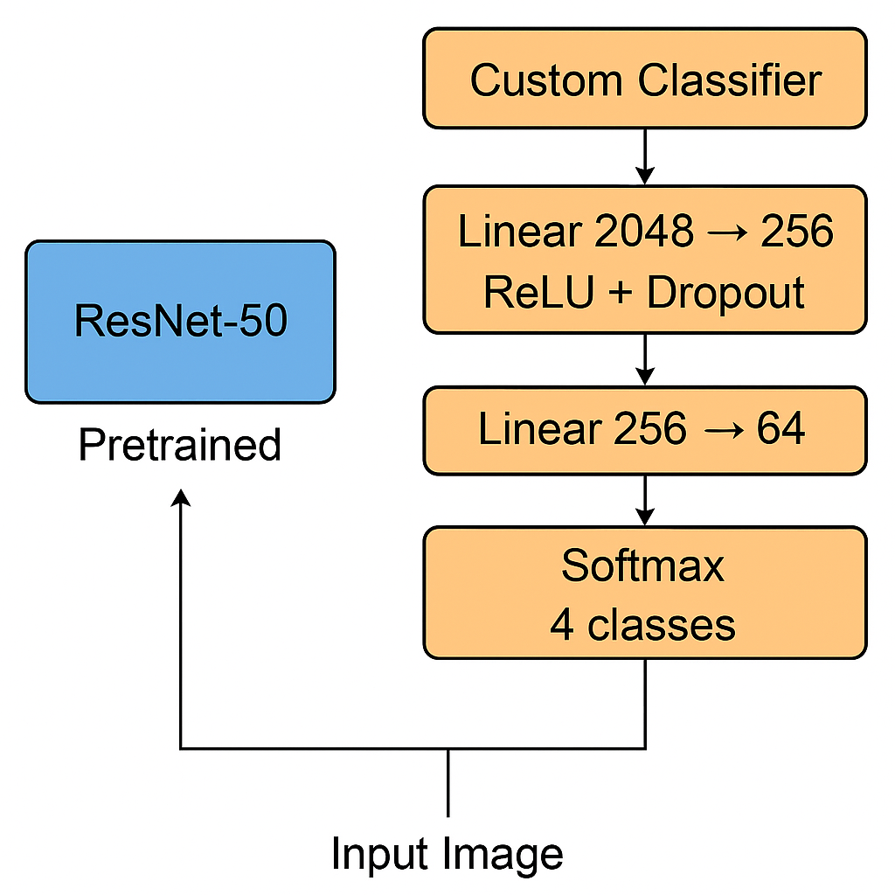
Model Architecture
Backbone: Pretrained ResNet50 from ImageNet
Custom Classification Head:
Fully connected layers: 2048 → 256 → 64 → 4
ReLU activation between layers
Dropout layers (0.3) for regularization
Output Layer: Softmax for multi-class classification (4 classes)
Loss Function: CrossEntropyLoss
Optimizer: Adam

Slide 9
Deployment with Streamlit
Developed an interactive Streamlit web application to host the model
Deployed using Streamlit Cloud with GitHub integration for easy version control
App allows users to upload the trained .pth model and an image of an apple leaf
Automatically preprocesses the image, runs inference, and displays predicted class and confidence scores
Designed for ease of use on web browsers with no installation needed
Streamlit provides a lightweight and beginner-friendly deployment experience

Slide 10
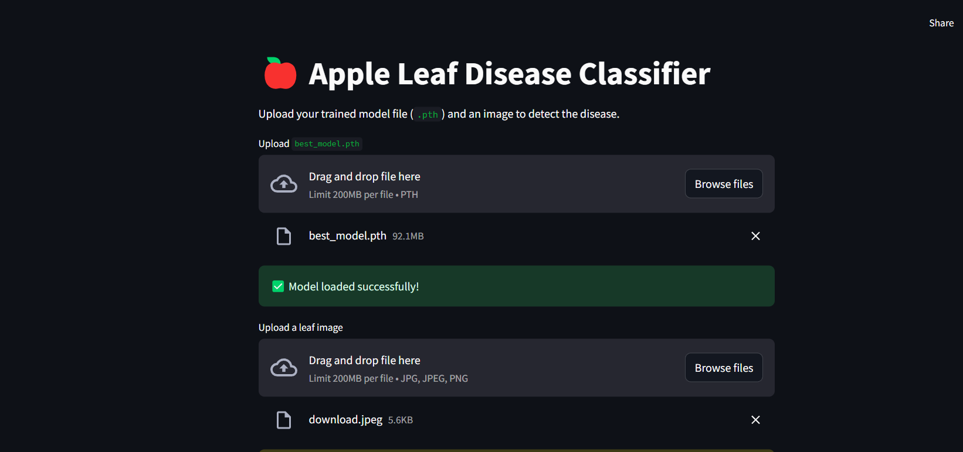
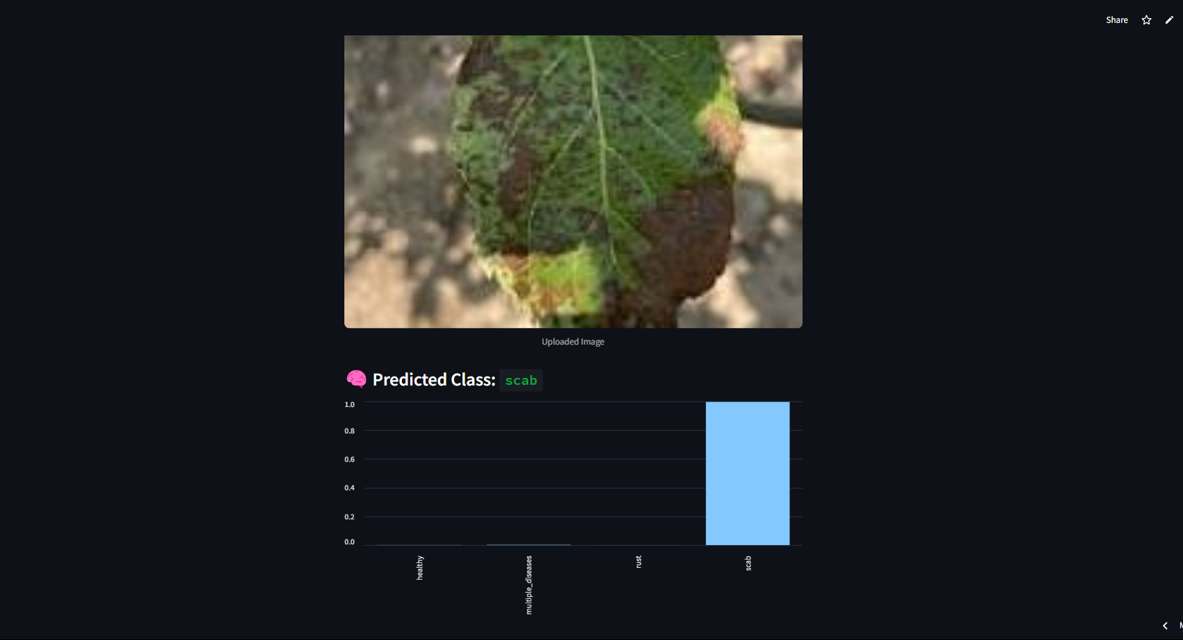
Output Images On Streamlit

Slide 11
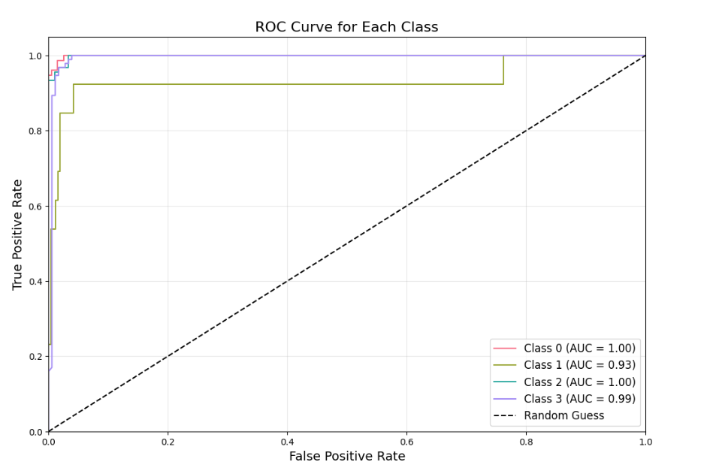
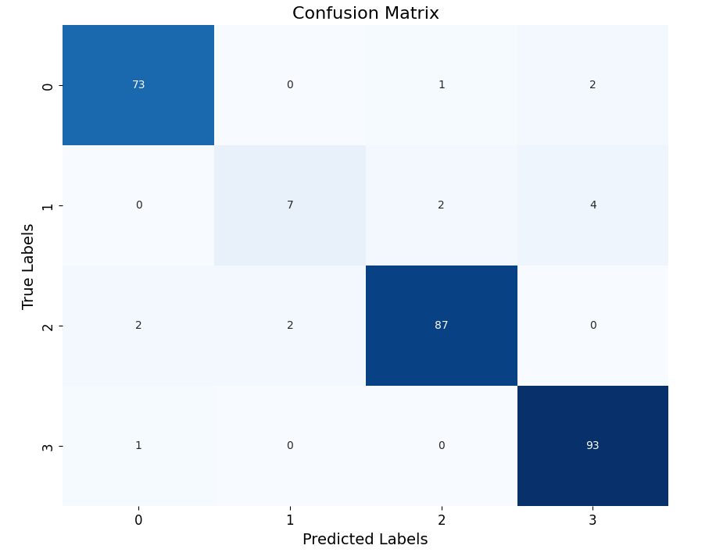
Confusion Matrix And Roc Curve

Slide 12
Final Results
Started with a balanced dataset of 1,800+ apple leaf images
Performed detailed preprocessing including resizing, normalization, and cleanup
Compared various CNN architectures (Simple CNN, ResNet18, EfficientNet, etc.)
ResNet50 showed the best tradeoff between performance and complexity
Built and deployed a fully functional Streamlit app for real-time predictions
Achieved strong accuracy and clear class separation (ROC curves & confusion matrix)

Slide 13
What We Learnt
Importance of Data Quality: Ensuring accurate labels and consistent image formats helped improve training and generalization.
Value of Pretrained Models: Leveraging ResNet50 significantly reduced training time and boosted performance.
Ease of Deployment with Streamlit: Streamlit provided a simple, fast, and interactive interface to demonstrate real-time predictions.
Practical Constraints in Hosting: File size limitations on Streamlit Cloud required adding model upload functionality to keep deployment flexible.
Real-World Impact: Showcased the potential of AI-based tools for disease detection in agriculture, supporting decision-making for farmers and researchers.

Slide 14

Thank you

